Slide 2


Stock Market Analysis P97 – Group 2

Slide 3



Presented By
Piyush Mahajan
Tushar Khutale
Rushabh Rode
Geetanjali Vijaykumar
Mentor
Karthik
Himavanth

Slide 4



Business Problem
To predict the outcomes, trends, or expected future behavior of business, industry sector, or the economy using statistics.

Slide 5

OBJECTIVE
The goal here is to make the companies and businesses to understand and analyse the market to lower their expenses and enhance profits along with helping the investors in identifying purchasing and selling patterns by using Modern Data Analytics.

Slide 6

FORECASTING
In simple terms forecasting means, “estimation or prediction of future”.
Forecasting is an operational research technique used as basis of management planning and decision making.
Forecasting is a systematic guessing of the future course of events.
Forecasting provides a basis for a planning.
According to Henry Foyal, Forecasting includes both accessing the future and making provision for it.

Slide 7
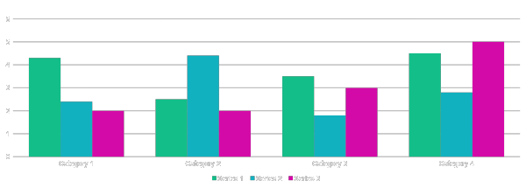
Chart

Slide 8
Table
 | Category 1 | Category 2 | Category 3 | Category 4
Item 1 | 4.5 | 2.3 | 1.7 | 5
Item 2 | 3.2 | 5.1 | 4.4 | 3
Item 3 | 2.1 | 1.7 | 2.5 | 2.8
Item 4 | 4.5 | 2.2 | 1.7 | 7

Slide 9
The way to get started is to quit talking and begin doing.
Walt Disney

Slide 10




Team
Name
Name
Name
Name
Title
Title
Title
Title

Slide 11
Timeline
To start a presentation, go to the Slide Show tab, and select From Beginning.
During your presentation, the speaker notes are visible on your monitor, but aren't visible to the audience.
If you don’t see the Notes pane or it is completely minimized, click Notes on the task bar across the bottom of the PowerPoint window.
Title
Title
Title
Title
Title
To display Presenter view, in Slide Show view, on the control bar at the bottom left select the three dots, and then Show Presenter View.
The Notes pane is a box that appears below each slide. Tap it to add notes.

Slide 12
Content
SUBTITLE
SUBTITLE
Add text, images, art, and videos.
Add transitions, animations, and motion.
Save to OneDrive, to get to your presentations from your computer, tablet, or phone.
Open the Design Ideas pane for instant slide makeovers.
When we have design ideas, we’ll show them to you right there.

Slide 13
Content 2
SUBTITLE
SUBTITLE
SUBTITLE
Add text, images, art, and videos.
Add transitions, animations, and motion.
Save to OneDrive, to get to your presentations from your computer, tablet, or phone.
Open the Design Ideas pane for instant slide makeovers.
When we have design ideas, we’ll show them to you right there.
Add text, images, art, and videos.
Add transitions, animations, and motion.
Save to OneDrive, to get to your presentations from your computer, tablet, or phone.
Open the Design Ideas pane for instant slide makeovers.
When we have design ideas, we’ll show them to you right there.
Add text, images, art, and videos.
Add transitions, animations, and motion.
Save to OneDrive, to get to your presentations from your computer, tablet, or phone.
Open the Design Ideas pane for instant slide makeovers.
When we have design ideas, we’ll show them to you right there.

Slide 14

Summary
With PowerPoint, you can create presentations and share your work with others, wherever they are. Type the text you want here to get started. You can also add images, art, and videos on this template. Save to OneDrive and access your presentations from your computer, tablet, or phone.

Slide 15


Thank You
Presenter name
Email address
Website address

